Slide 1
Sellables CSAD DCPE/2B/04
Reyes Tham Meng Feng (P2124661) Nathaniel Teo Rui Yang (P2124463) Theodore Lim Zhi Yang (P2124546) Yang Baiquan (P2111632)

Slide 2
Table of contents
01
Introduction
04
Website Contents
02
Website UI Design
05
Conclusion
03
Project Database

Slide 3
01.
Sellables
A User to User Marketplace

Slide 4

Our Team
Reyes
Nathaniel
AstraDB Database Login/Register Page. Chat Page. Sell item Page. Profile Picture Uploader
Homepage Item Page Category Page Header and Footer
Theodore
Baiquan
Profile Page Review Page About Page
Design Bootstrap

Slide 5
Sellables is a virtual marketplace that allow users to list items for selling or buying to and from other users around Singapore

Slide 6
02.
The Design

Slide 7
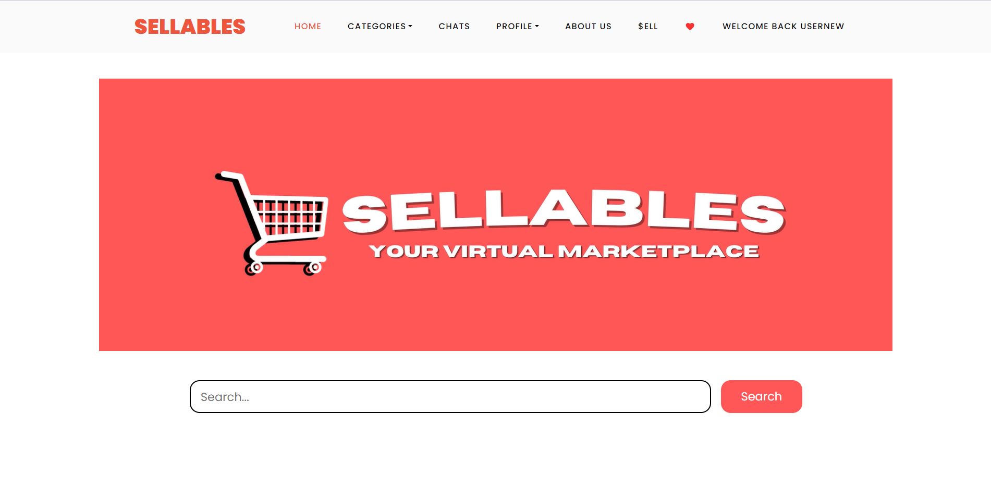
The Design of our website
Username
NavigationBar
Video Banner
White Background
Design using Bootstrap V4

Slide 8
03.
ASTRADB
Accessed using REST API & Javascript methods. Stores & provides all the data in our website, Sellables.

Slide 9
Tables Utilising AstraDB
Account Data Table
Item Data Table
Chat Group Data Table
Message Data Table
Like Data Table
Review Data Table
Description Data Table

Slide 10
Account Data Table
[Text Type] Used to determine the username of the user
Account Table
Username (PK)
Email (PK)
Password (PK)
Profile Image
[Text Type] Used to determine the email of the user
[Text Type] Used to determine the password of the user

Slide 11
Item Data Table
Items Table
Id (PK)
Category
Condition
Description
Latitude
Longitude
Method
Name
Sold
Picture Data
[Text Type] Stores Categories such as fashion, electronics and food
[Decimal Type] Used to store latitude and longitude of meet up location
[Int Type] Used to store whether the item is sold or not

Slide 12
Chat & Message Table
Message Table
ID (PK)
Group ID (FK)
User 1
User 2
Sender
Message
Chat Table
Group ID (PK)
Title
User 1
User 2

Slide 13
Like Table
[int Type] Used to access unique rows, auto increments with every new row
Like Table
ID (PK)
Item ID
Username
[int Type] Used to identify the item that was liked
[Text Type] Used to link the user with their liked items through their username

Slide 14
Review Table
[int Type] Used to determine the rating given to the user
Account Table
ID (PK)
Rating
Review
Buyer
Seller
[Text Type] Used to determine the rating given to the user
[Text Type] Used to determine the review from the buyer
[Text Type] Used to determine the review from the seller

Slide 15
Description Table
[Text Type] Used to determine the username of the user
Account Table
Username (PK)
Description
[Text Type] Used to determine the description of the user

Slide 16
Profile Images Table
[Text Type] Used to determine the username of the user
Account Table
Username (PK)
Picdata
[Text Type] Used to determine the profile image set by the user

Slide 17
04.
Web Contents

Slide 18
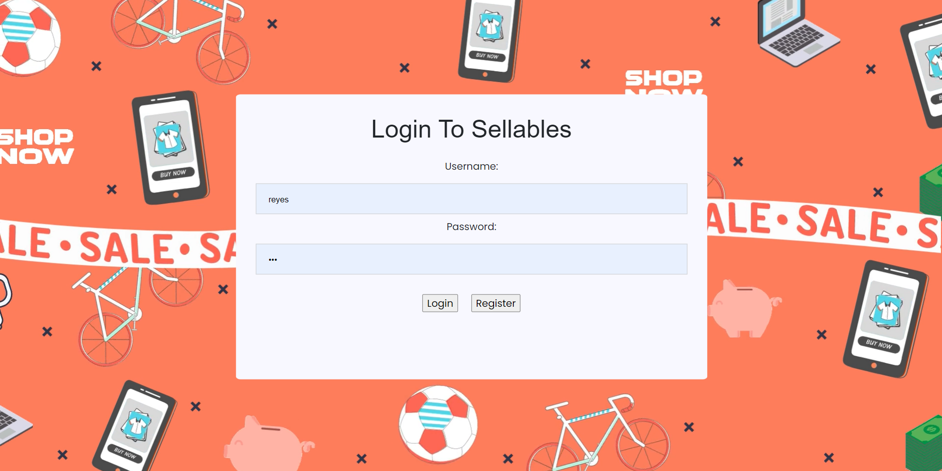
Login Page
Embedded Video Background
Option For login/Register

Slide 19
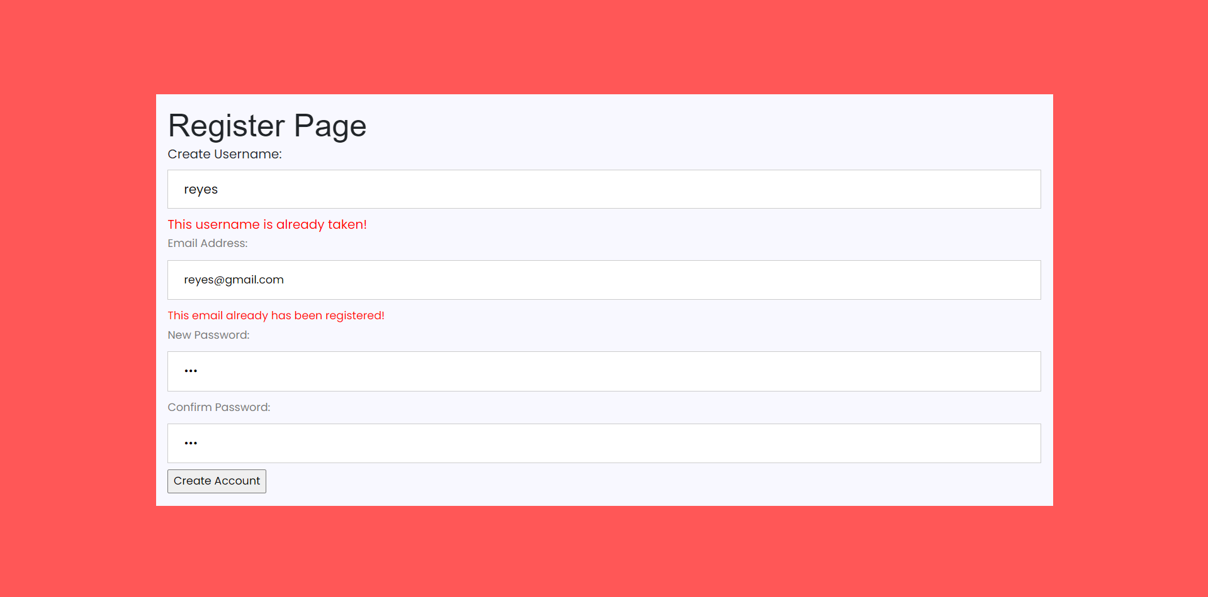
Register Page
Account Creation with NO Duplicate Username/Emails

Slide 20
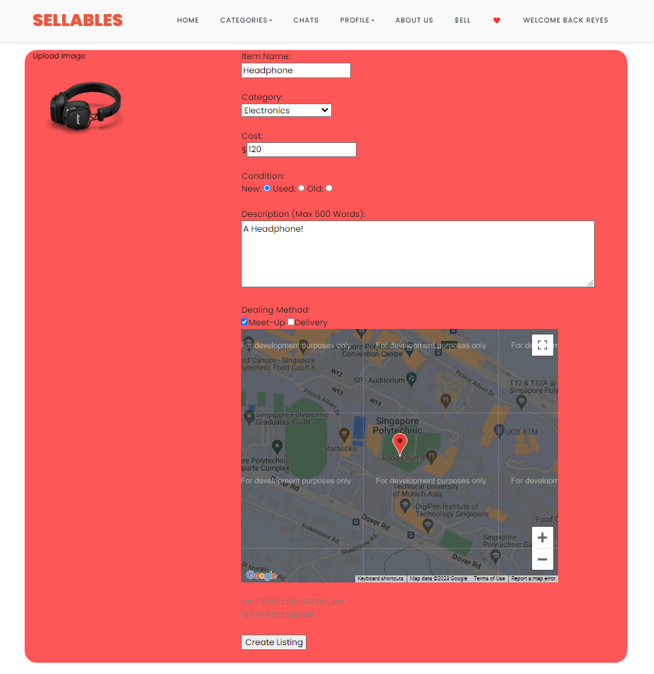
Sell Page
Image Uploader
Item Details
All these information will be stored within the AstraDB database under the items table
Draggable Map To Select Meetup Location

Slide 21
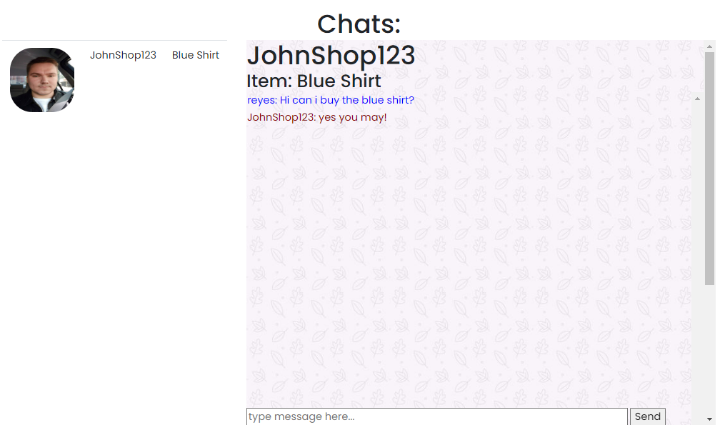
Chat Page
Chat Iframe [Refreshes every 500ms]
Messages Read from Database [based on groupid and sender]
Seller Details

Slide 22
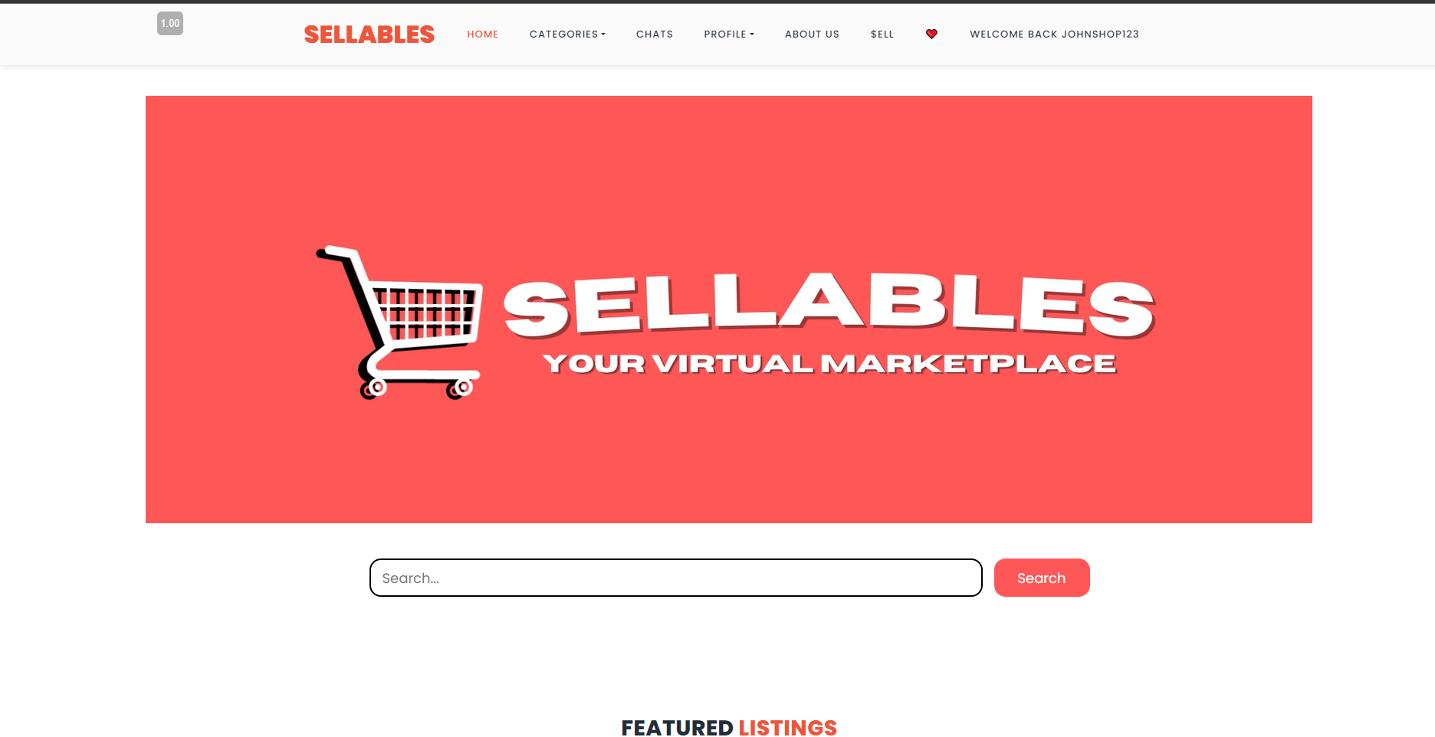
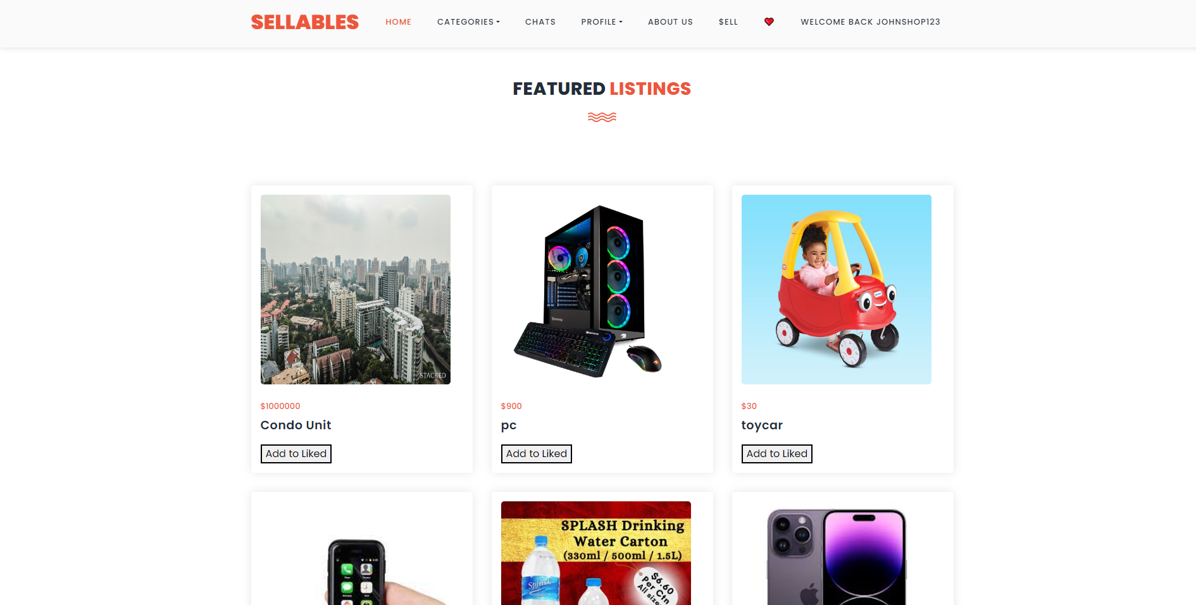
Home page
Nav Bar
Embedded Video (Banner)
Search Bar
Item Listings

Slide 23
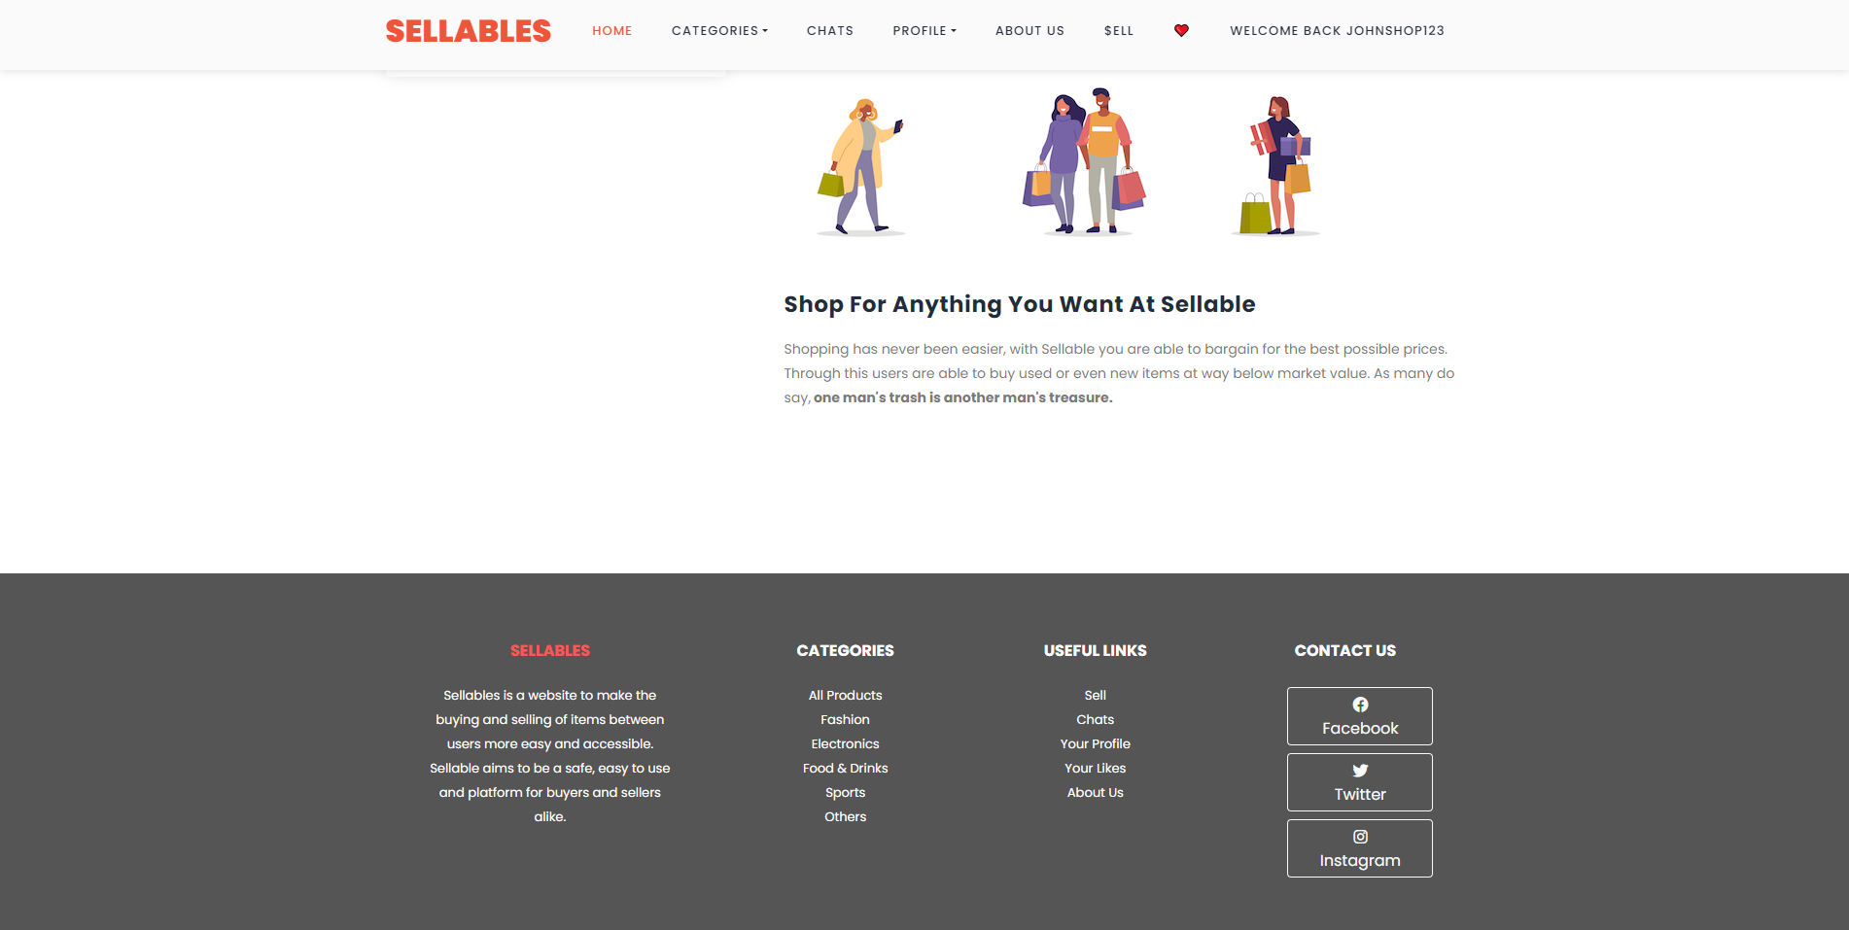
Footer Page
Site Summary
Social Media Links
Site Navigation Links

Slide 24
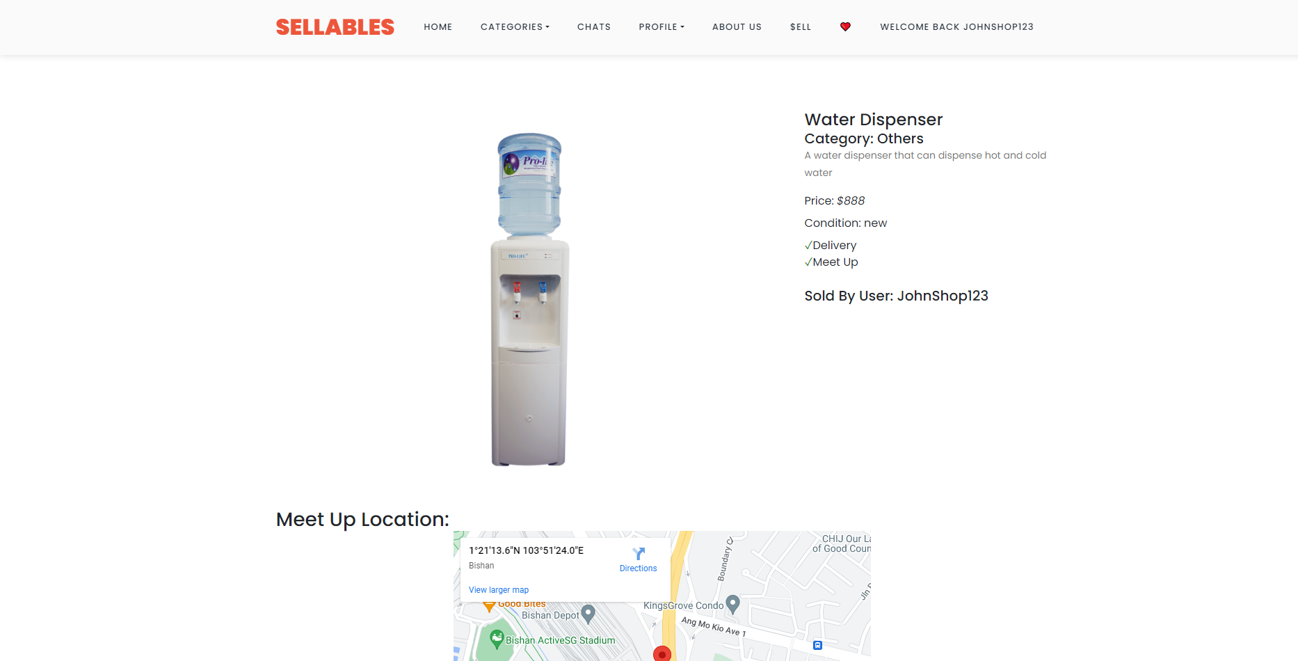
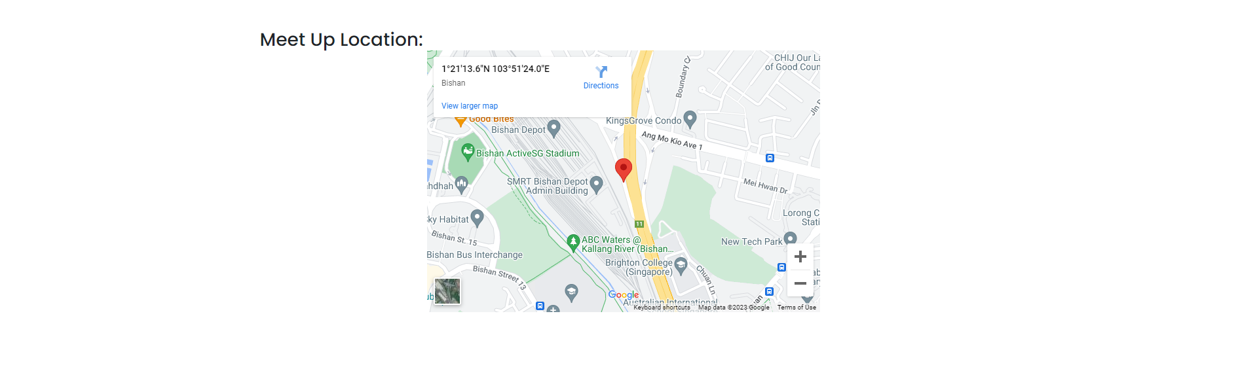
Item Page
Item Details
Google Maps Display Meetup Location

Slide 25
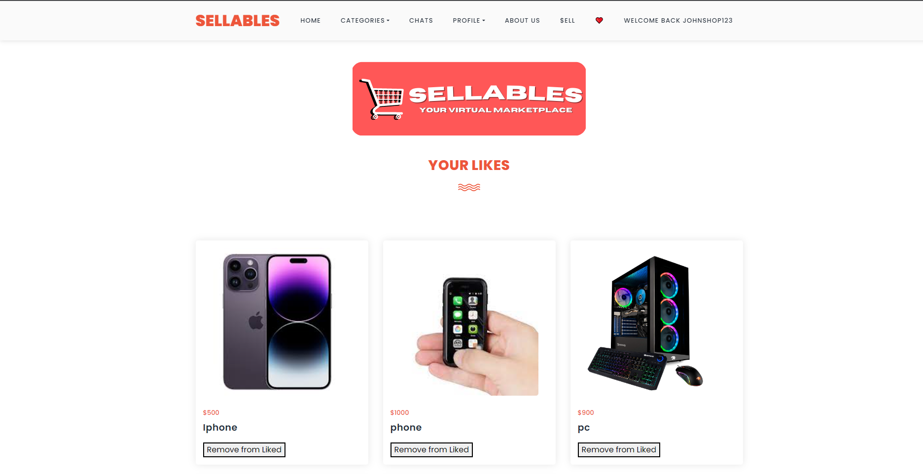
Like Page
Liked Items
Like/Unlike Buttons

Slide 26
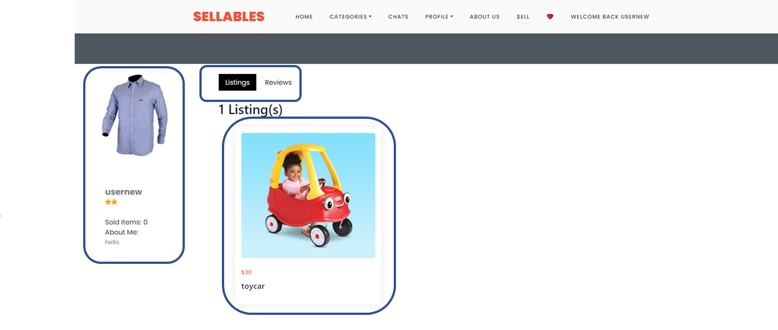
Profile Page (Listing)
Profile
Navigation
User Information
User Listings

Slide 27
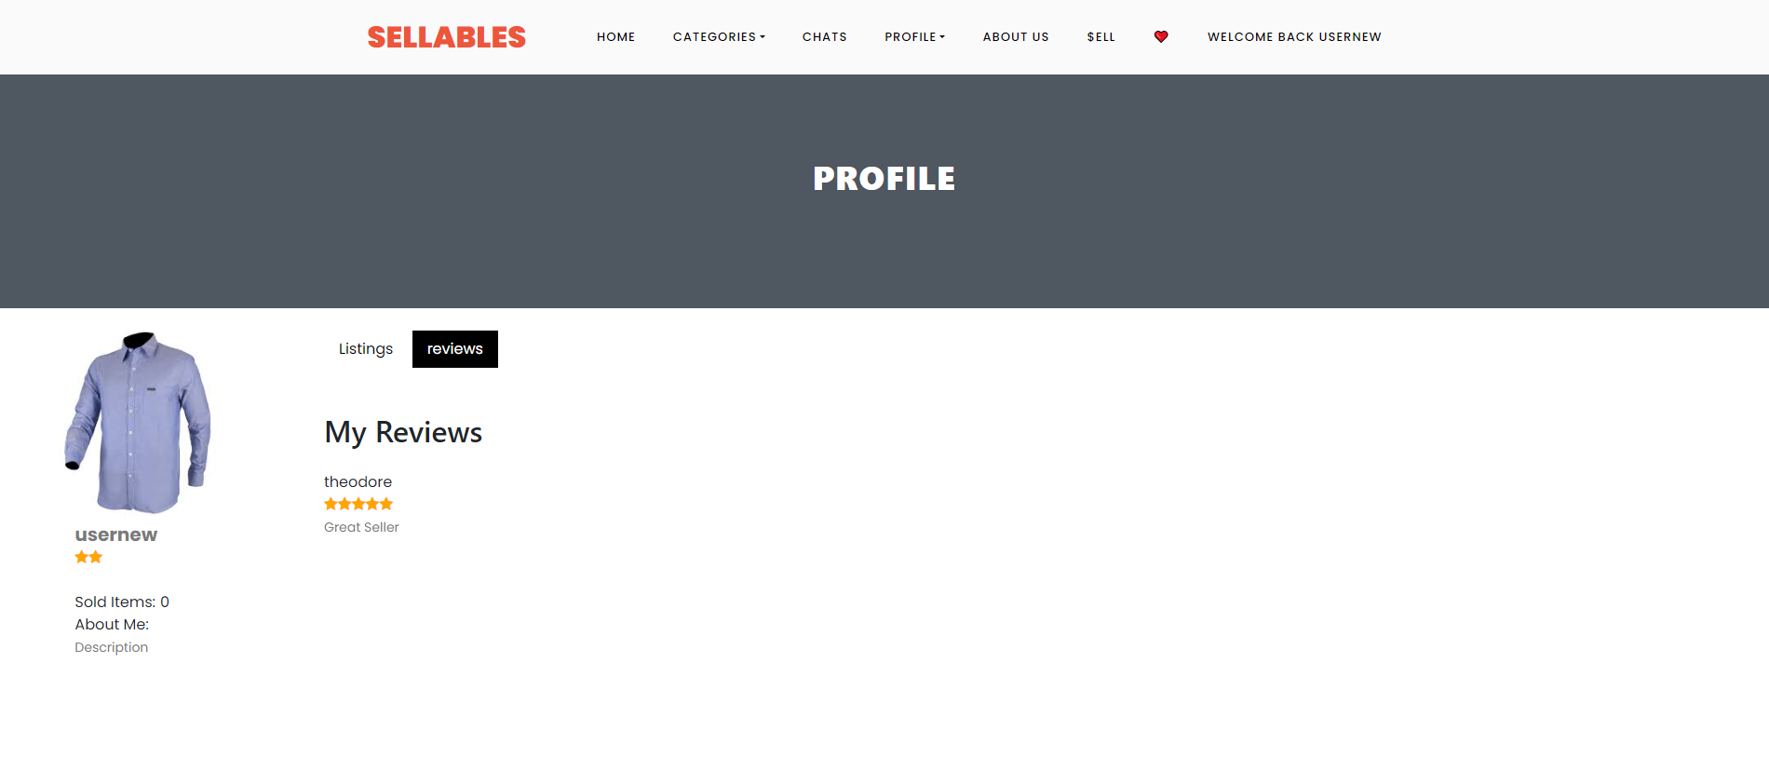
Profile Page (User Review)
User Review

Slide 28
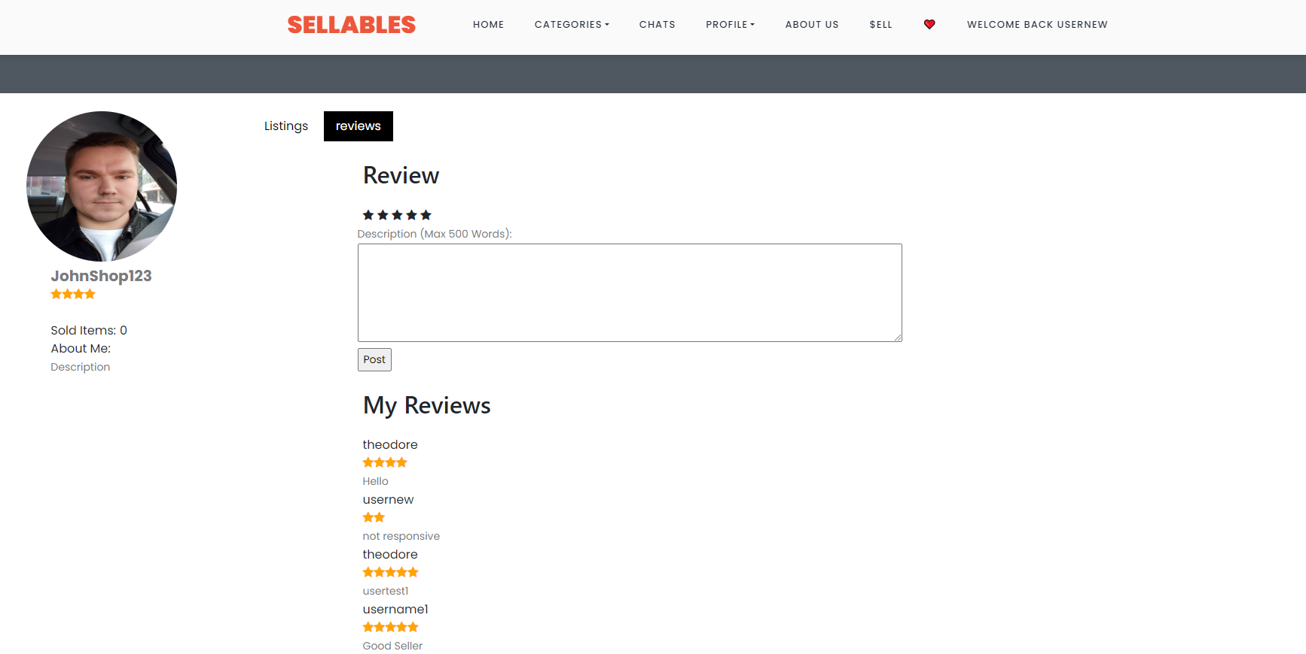
Profile Page (Seller)
Buyer Review

Slide 29
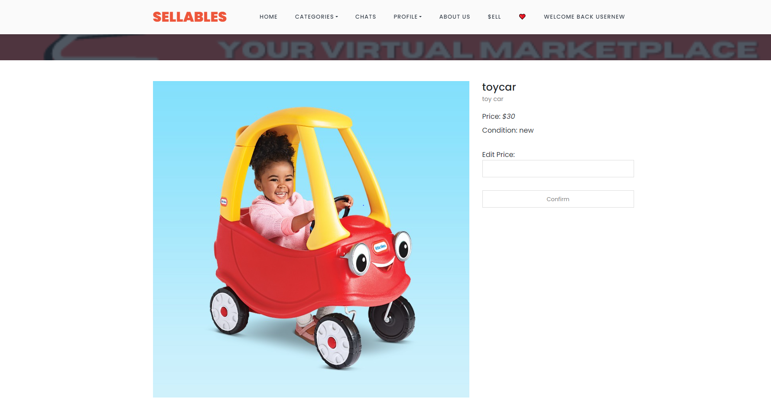
Profile Page (Listing)
Edit Item Price

Slide 30
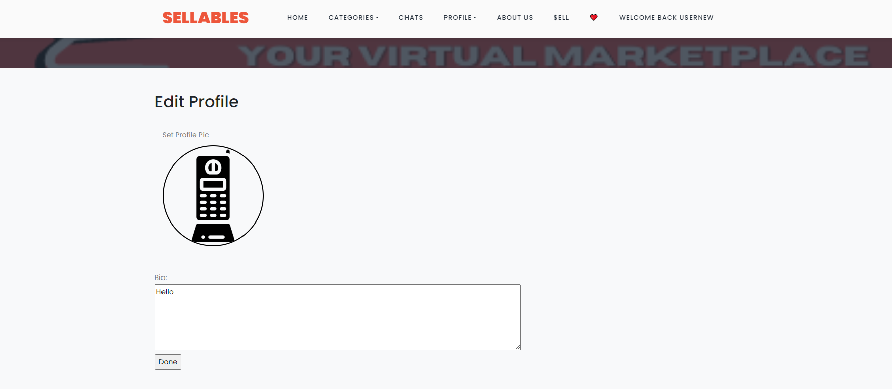
Profile Page (Listing)
Profile Description
Profile Image

Slide 31
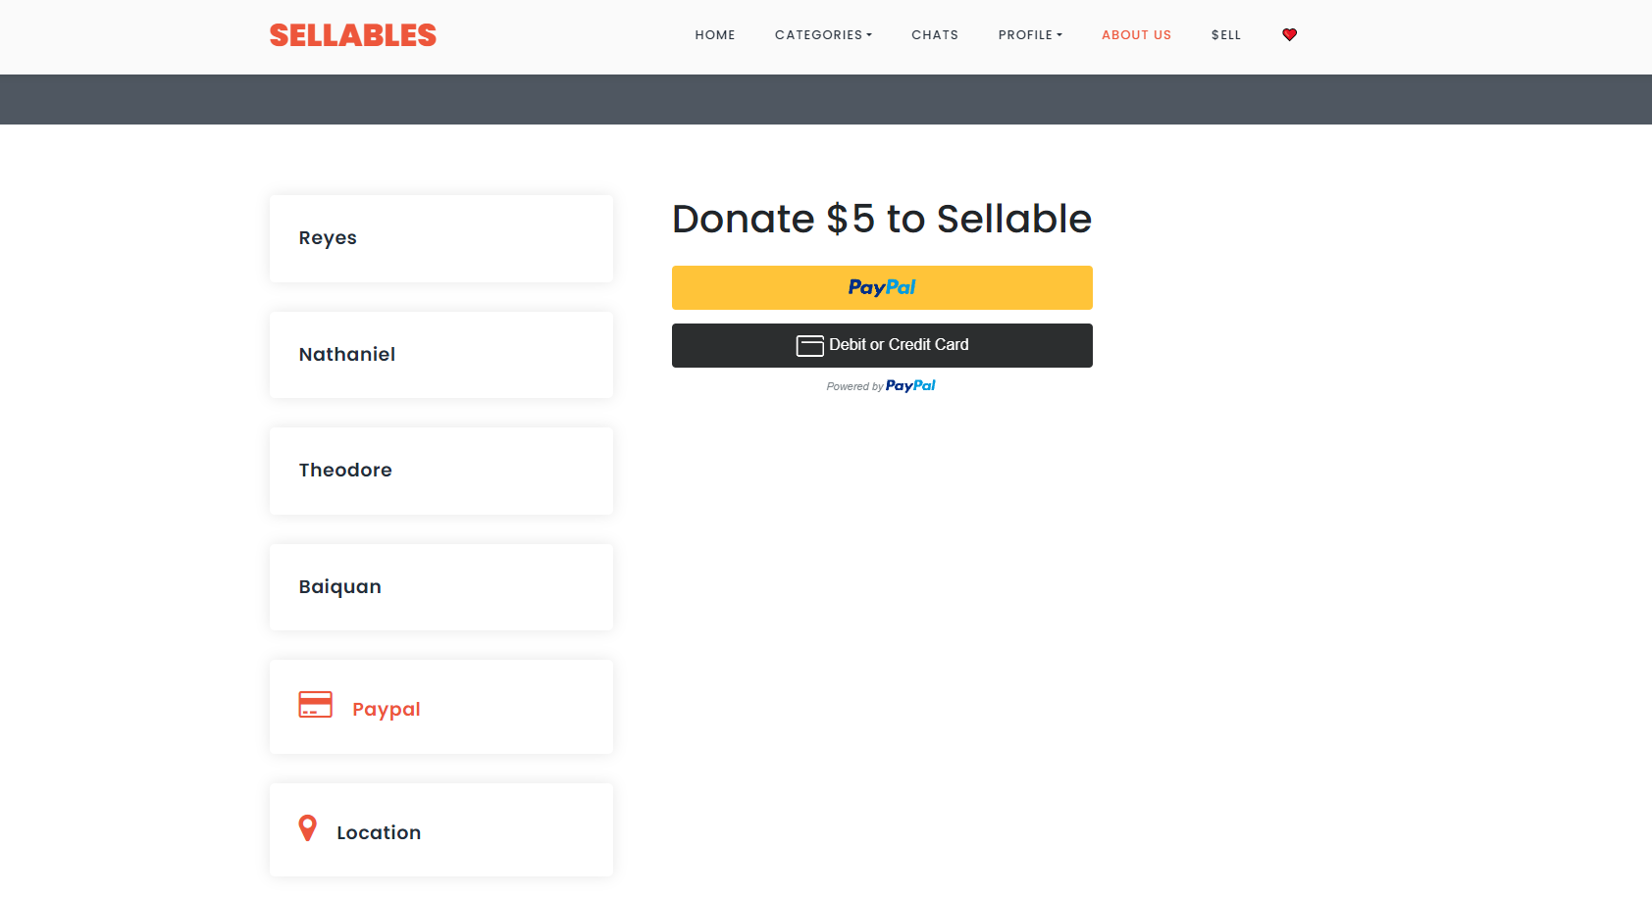
Paypal
Paypal

Slide 32
05.
Conclusions

Slide 33
Conclusions
Concluding Statement
Database
Standout Features
Sellables has a real world application of providing a platform where users are able to sell their unwanted items, or buy other user’s items for cheaper prices. In essence, Sellables is a virtual marketplace which makes selling or buying items online much easier and accessible.
Utilising AstraDB along with REST API and Javascript methods to store and retrieve data such as item listings, liked items, user account details & chat messages.
Includes the chat function, bookmark/liked items , user reviews, login/register account feature, search item feature, user shop/profile feature

